Slide 1



Ben-Gurion University Of The Negev Faculty of Engineering Biomedical Engineering
Analysis calls of mouse pups as a
means of predicting autistic behavior
Supervisors: Prof. Golan Hava Dr. Lederman Dror
Student: Weinberger Shaked

Slide 2


Background
What is ASD?
Current diagnosis methods
Average diagnosis age 4-5 years
Early diagnosis of ASD is particularly important
2

Slide 3
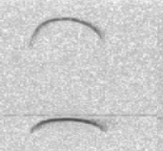
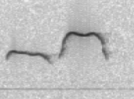
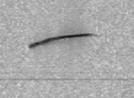
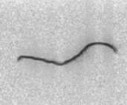
Background
MTHFR deficiency increases the risk of ASD symptoms
Why mice model?
USV - UltraSonic Vocalizations
120
Frequency [kHz]
40
Time [ms]
Figure 1: Examples of syllables and their presentation of a spectrogram
3

Slide 4
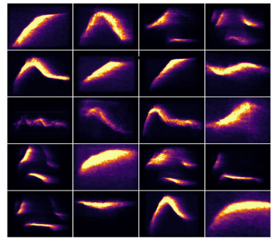
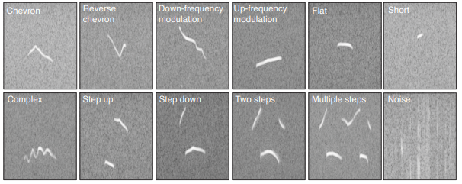
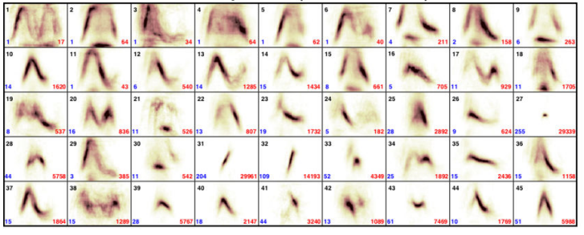
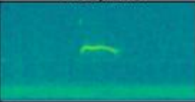
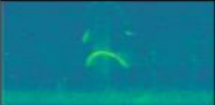
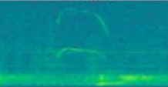
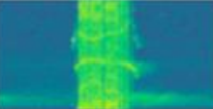
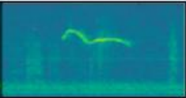


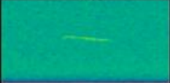
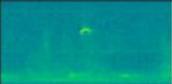
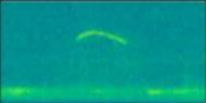
Literature review
Previous works focused on syllables classification
(a) A. H. Fonseca, G. M. Santana, G. M. Bosque Ortiz, S. Bampi, and M. O. Dietrich, 2021
(c) K. R. Coffey, R. G. Marx, and J. F. Neumaier, 2019
Two syllable
Frequency steps
Composite
Harmonic
Complex
(c)
Upward
Downward
Flat
Short
Chevron
(d) G. Lavy and V. Wolfman, 2021
(b) M. Van Segbroeck, A. T. Knoll, P. Levitt, and S. Narayanan, 2017
4
Figure 2: Examples of studies that classify syllables: (a) MUPET, (b) DeepSqeak, (c) VocalMat, (d) BGU model

Slide 5
Project Goal
Develop a machine-learning-based model to detect ASD that based on analyzes of USVs signals.
Goals:
Developing a unified model.
Test the diagnostic capabilities on recordings files that have not been manually segmented and classified for syllables.
5

Slide 6
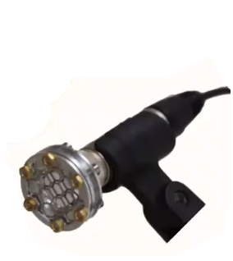
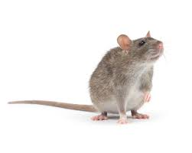
Dataset Background
Dataset contain 27,000 recording files of young mice.
~1000 manually analyzed recordings files.
Recording 24 additional mice this year.
6

Slide 7
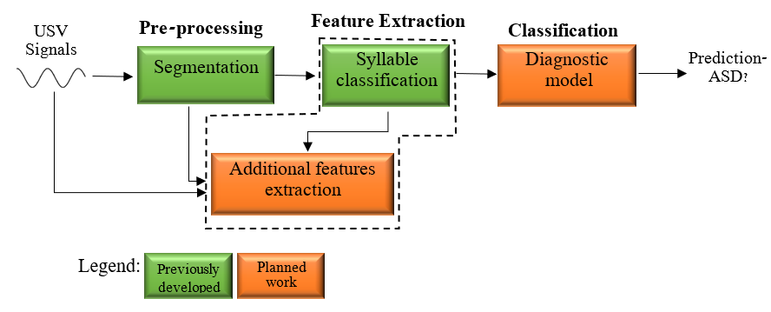
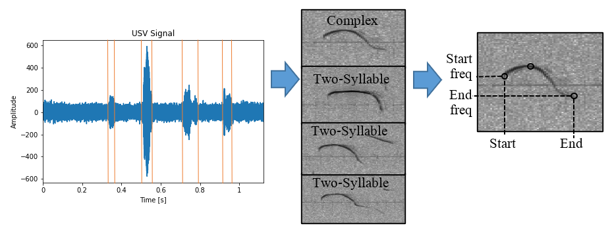
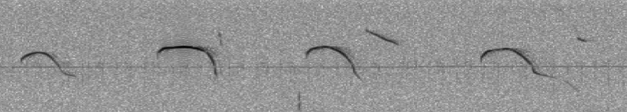
Model
Figure 3: A general scheme of the proposed system
USV Signal
Syllable
Burst
7
Figure 4: The process of analyzing USV signals

Slide 8
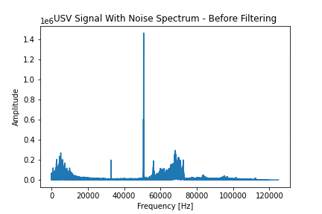
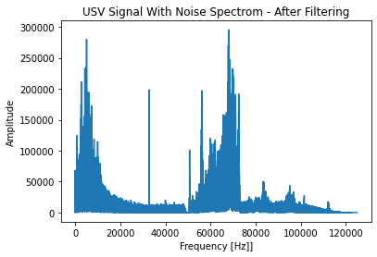
Segmentation
Methods:
Energy filter bank
Noise filtering
Results:
MSE: 0.0001 (time domain)
(a)
(b)
Figure 5:Signal spectrum before (a) and after (b) filtering
8

Slide 9
Methods - Feature extraction
7 prominent features, represented by 43 numbers
Syllable distribution (10)
Syllable mean start frequency (10)
Syllable mean end frequency (10)
Syllable mean duration (10)
Mother genotype (1)
Sex (1)
Mean time between syllables (1)
Start and end frequency - PSD
9

Slide 10
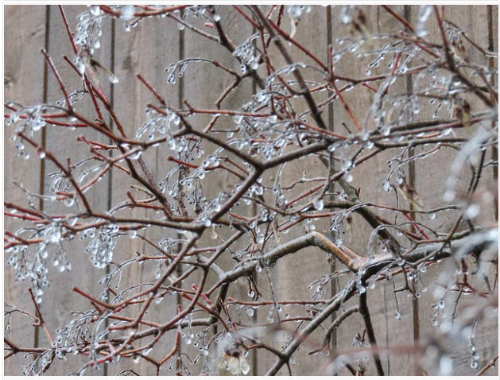
Methods - Final Classification
XGBoost:
Easy to use
Small dataset
Uses consecutive decision trees
Boosting – each tree focuses on previous tree’s error
10

Slide 11
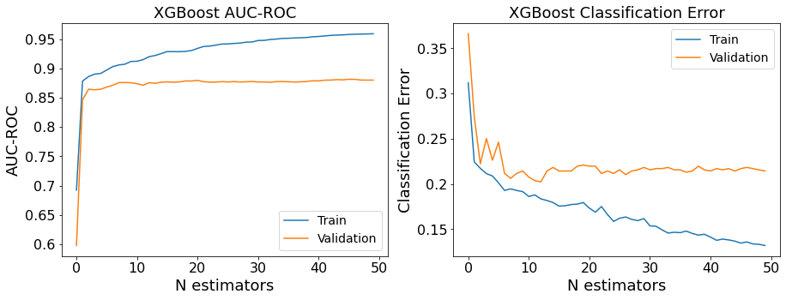
Results
63 mice
Training - 2250 recordings
Validation – 751 recordings
(a)
(b)
11
Figure 6: Accuracy (a) and error (b) of the model

Slide 12
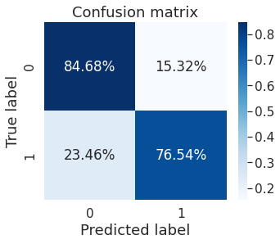
Results
(210)
(38)
Test – 751 recordings
79% Accuracy test
(118)
(385)
12
Figure 7: Confusion matrix for test set

Slide 13
Conclusions & Future steps
Conclusions:
For the first time a unified and automatic model.
For the first time using non-manually analyzed data.
Future steps:
Subject-dependent to subject-independent.
Extract additional features and focus on most relevant features.
13

Slide 14

Questions?

